Slide 1
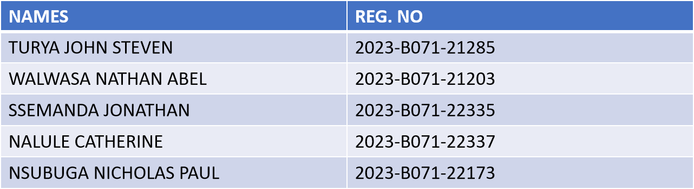
An analysis of online retail data
Group 2

Slide 2
Project workflow (overview)
Data ingestion and cleaning
Loaded multi-sheet Excel data (2009-2011).
Cleaned the dataset by removing 27% of records (cancellations, duplicates, nulls).
Preprocessing an EDA
Standardized item names for consistency.
Grouped sales into transaction baskets.
Analyzed top products and basket sizes to understand core customer behavior.
Advanced analysis and modeling
Transformed data into a one-hot encoded matrix for analysis.
Applied two market basket analysis algorithms: apriori and an optimized ECLAT.
Identified product association rules with varying support thresholds.
Interpretation and recommendation
Compared algorithm performance to identify the most efficient method.
Translated high-lift rules into actionable business strategies for bundling, cross-selling, and marketing.

Slide 3
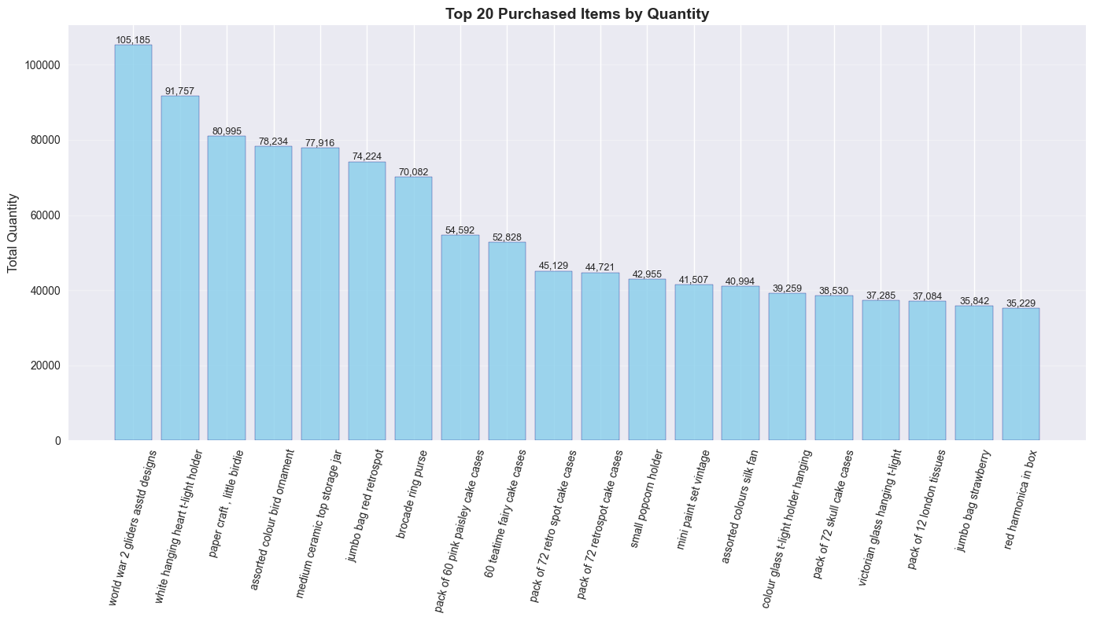
Top 20 purchased items.

Slide 4
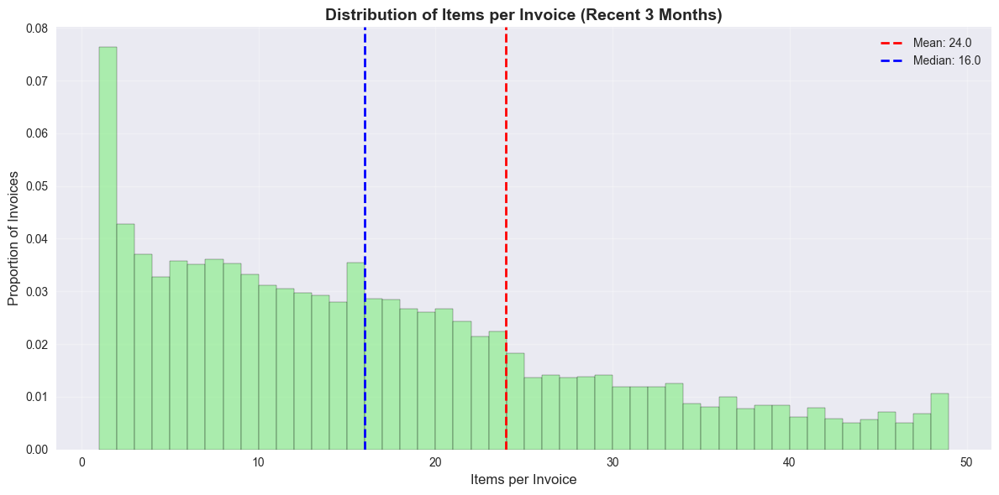
Customer Purchase Behavior

Slide 5
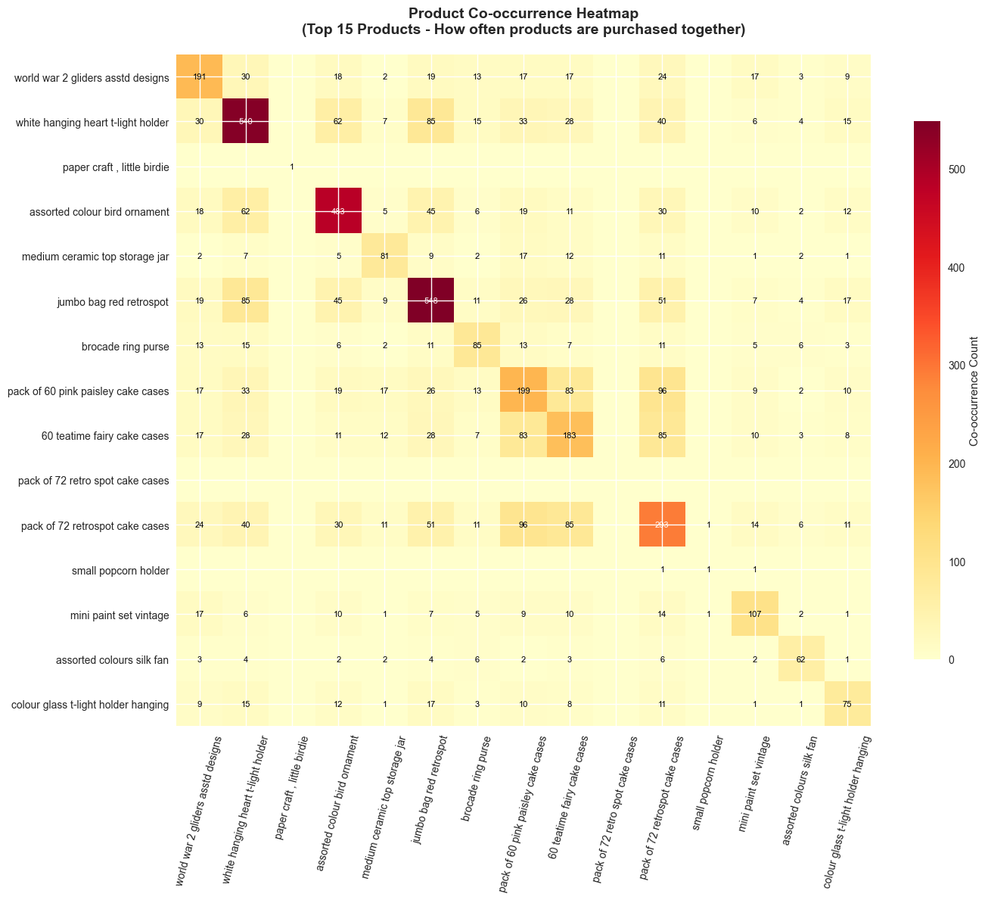
Products frequently bought together

Slide 6
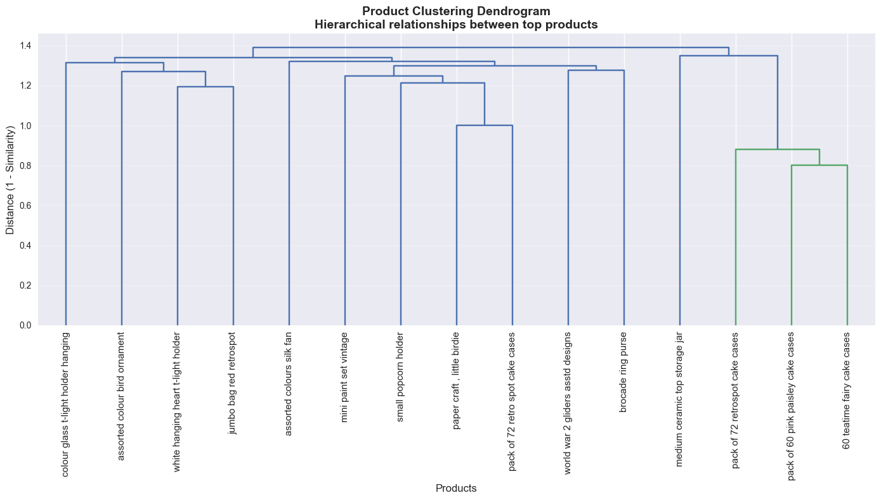
Data-driven product grouping

Slide 7
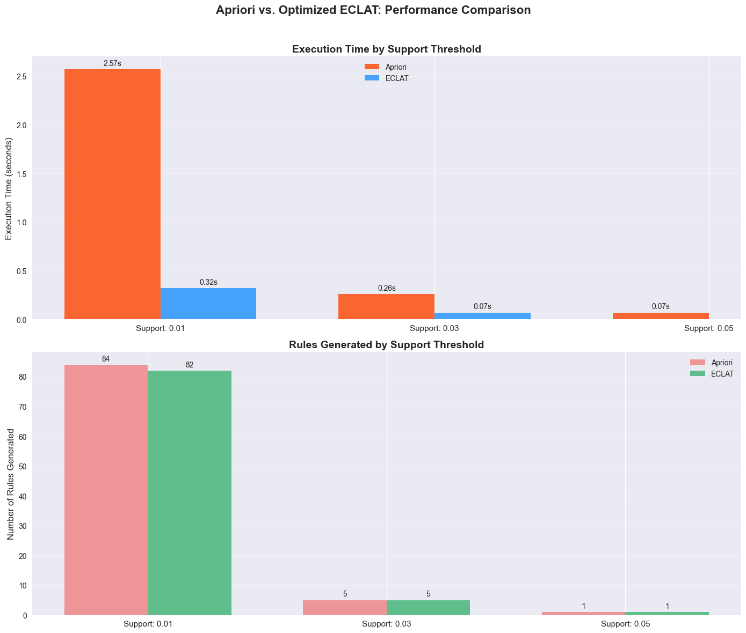
Algorithm Performance (which method is more efficient)

Slide 8
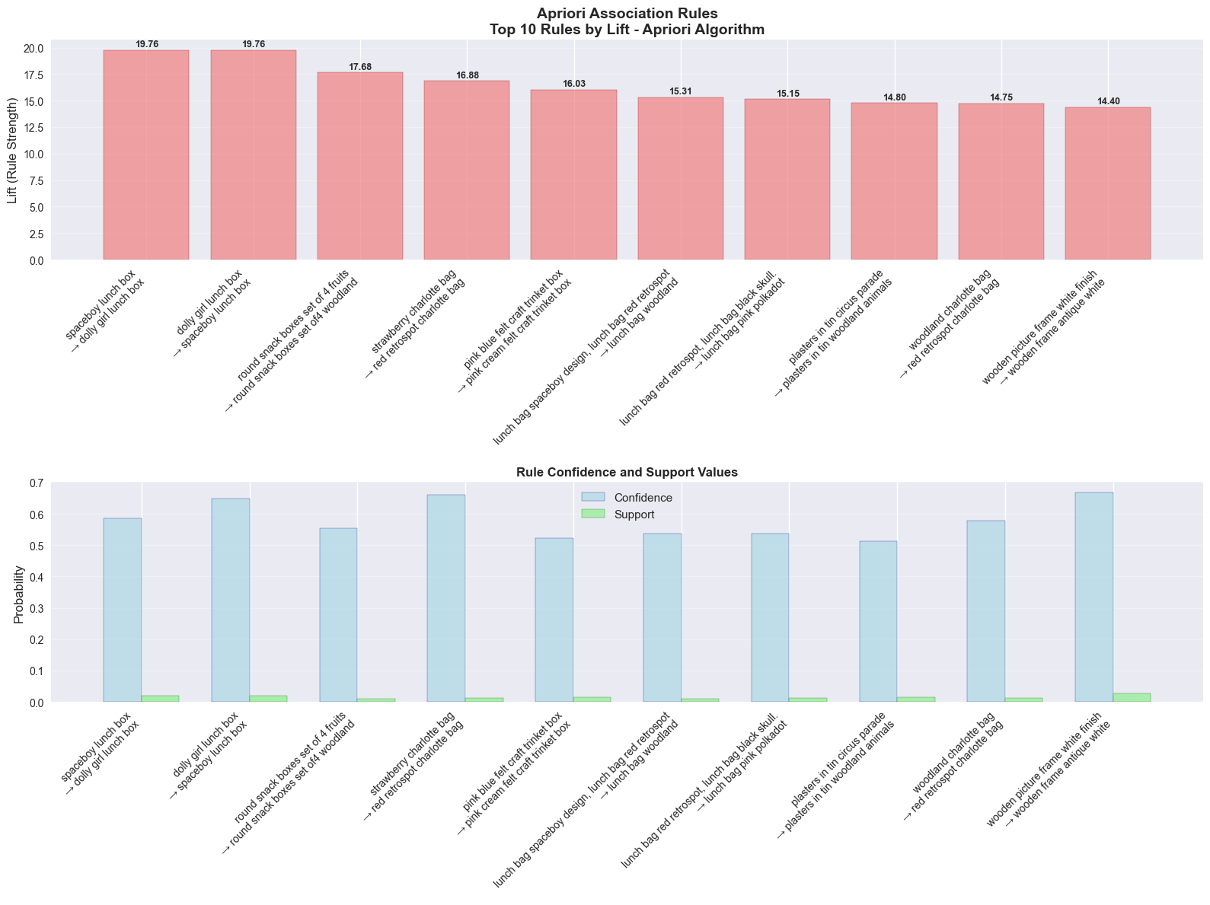
Visualizing the strongest association rules

